Slide 1
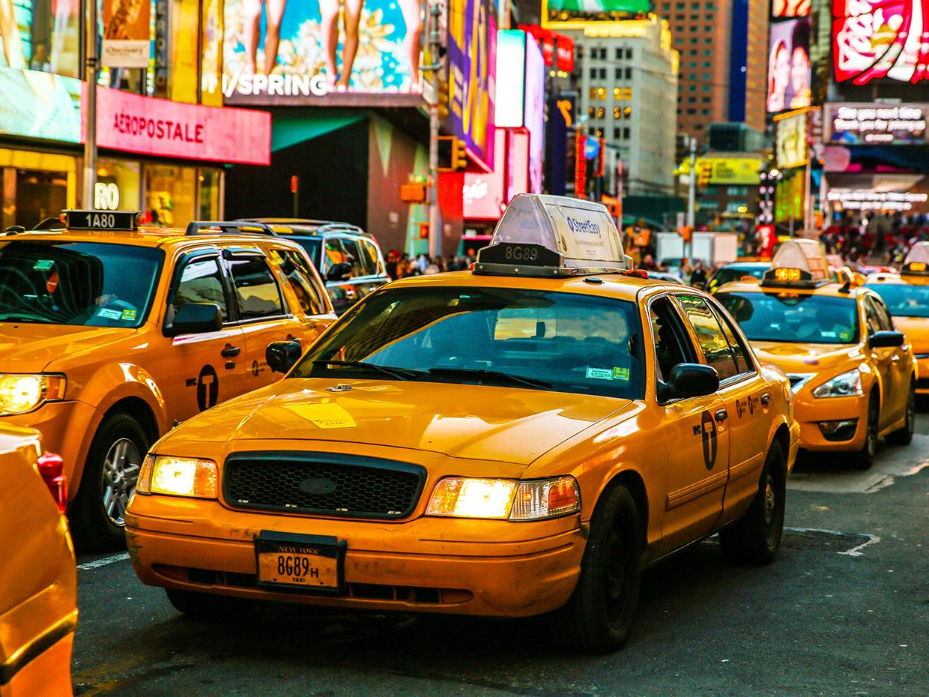
Taxi Prediction
Evan Joyce

Slide 2

Goals
Create a linear regression model
Predict the “fare_amount” of a trip
Test on other datasets

Slide 3

Data
Hundreds of datasets
Month
Year
Green and yellow taxi
Each month 5-12 million entries

Slide 4
Preprocessing
Omitting Columns
“Store_and_fwd_flag”
dates
No missing data!!(Shocker)

Slide 5
First results
Sklearn first
Perfect results!
How could this be?
Drop columns
.83
More data
.18
What happened!?!?

Slide 6
Take a Step Back!
More analysis
Crazy outliers!
-300
3000
Set new range
Did it help?

Slide 7
Next Steps
It works!
Now apply to spark
Test train %?

Slide 8
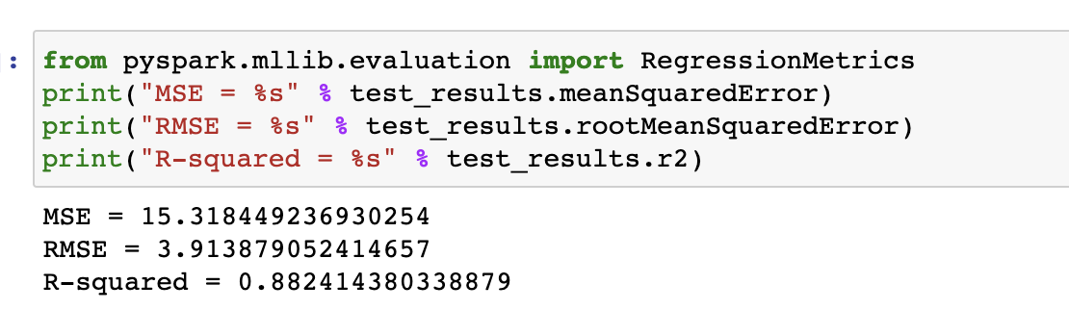
Results - January

Slide 9
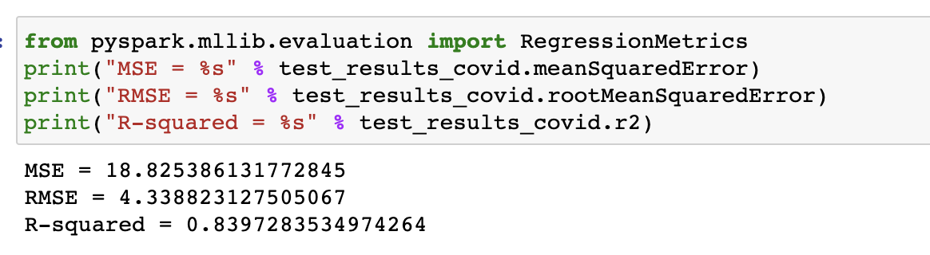
Results - Covid Month

Slide 10
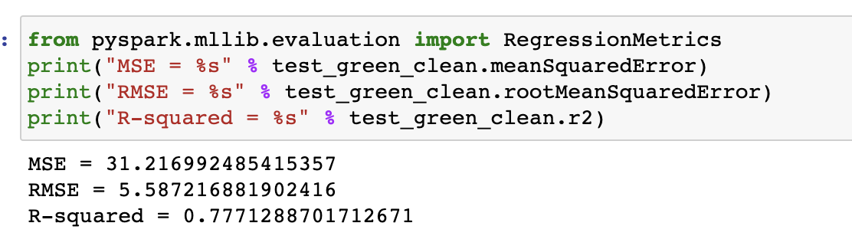
Results - Green Taxi

Slide 11
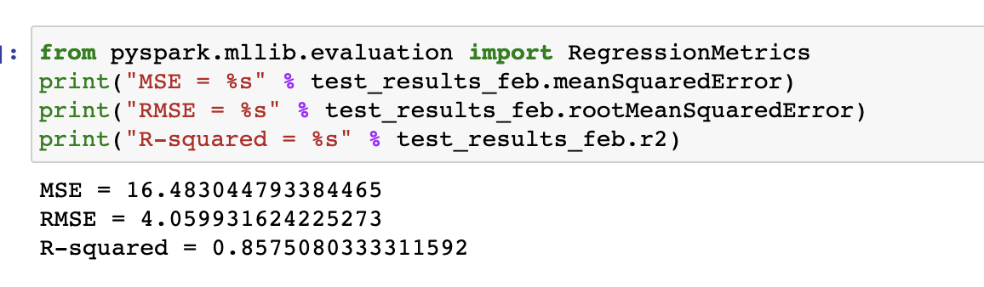
Results - February

Slide 12
Summary of Results
All were trained on January of 2019
Test Results
January 2019
R2 = .88
Covid Month - January 2020
R2 = .83
Green Taxis
R2 = .77
February 2019
R2 = .85

Slide 13

Conclusion
Accurate predictions!
Tested on different datasets
Utilized spark
Future Work

Slide 14


